Slide 1
Heat Sensitive Paint for
Thermal Camera Calibration
Supervisor: Pro. Wai Ho MOW
Author (Student ID): LI, Hoi Him (20585898)
LI, Hong Yin (20496853)
LO, Yat Hei (20692574)

Slide 2
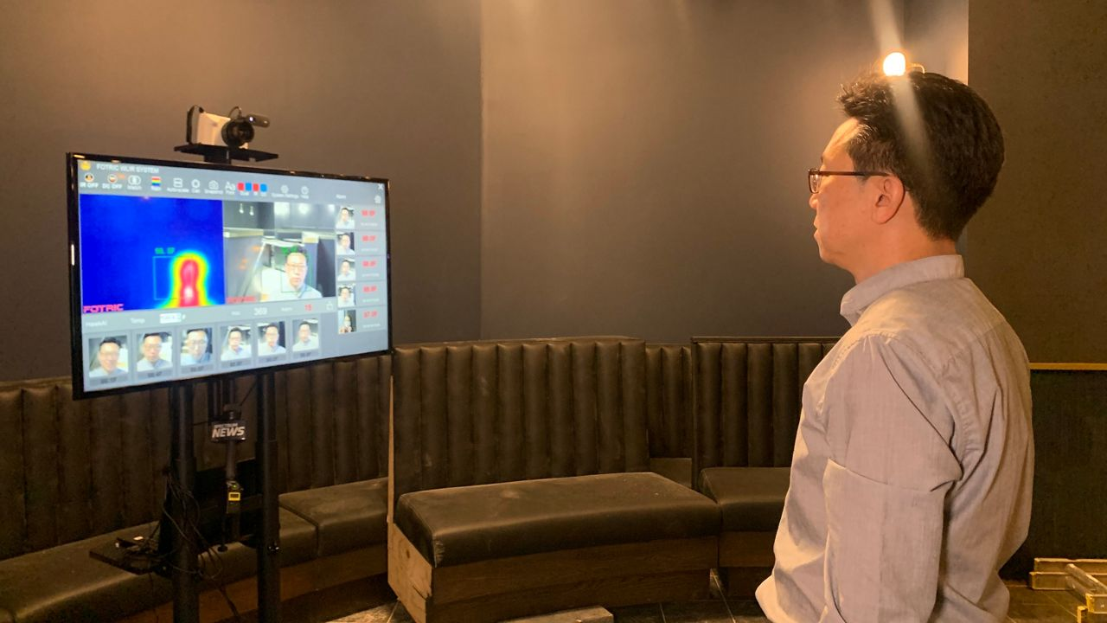
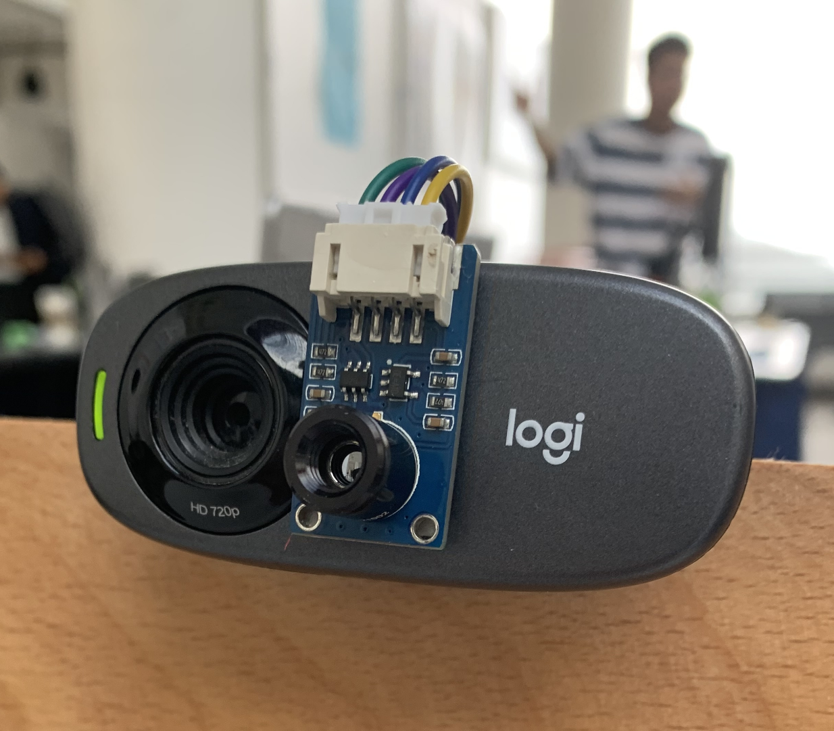
BACKGROUND
OBJECTIVE 1
OBJECTIVE 2
OBJECTIVE 3
INFRARED CAMERA
Creates thermal images based on infrared data
PROBLEM
They can’t accurately measure temperatures at a distance
RESEARCH GAP
Calibrators are expensive and complex
To set up a calibration area with the use of heat-sensitive paint
To calibrate thermal camera by tracking colour of heat sensitive paint
To track and display temperature of people at different distances

Slide 3
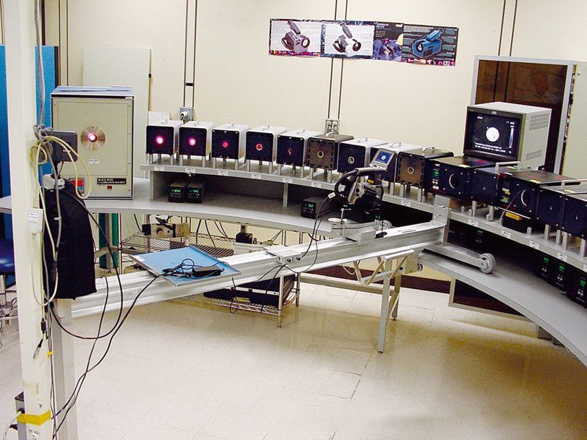
LITERATURE REVIEW 1
Multi-Point Calibration
Calibrated In A Lab
LOGO
ADVANTAGES
DISADVANTAGES
Camera is sent to lab to be calibrated with precise machines
Multiple blackbody reference sources built with extreme quality and high standards
Noiseless environment
Users don’t have to calibrate the camera themselves
The camera can be used without any extra setup
The camera has to be sent back to the lab every year

Slide 4
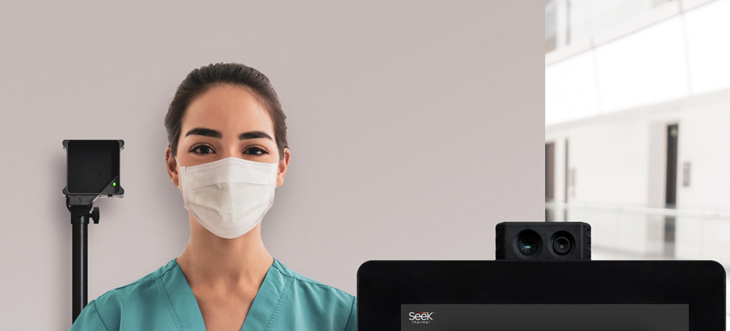
LITERATURE REVIEW 2
Kiosk
Calibrated Constantly
LOGO
ADVANTAGES
DISADVANTAGES
A blackbody reference source located in view of the camera
Camera recalibrates itself continuously
Camera is constantly calibrated
Expensive
Complex Setup
Requires People to Stand at Specific Location

Slide 5
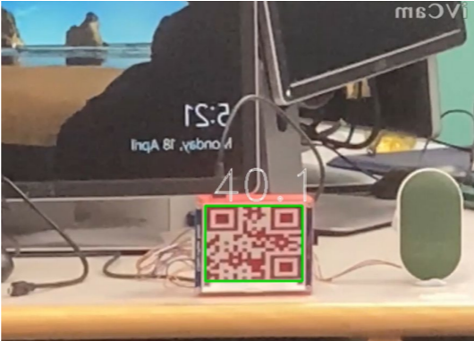
LITERATURE REVIEW 3
Temperature Sensor and Camera Feedback
Using a Variable Heat Source
LOGO
ADVANTAGES
DISADVANTAGES
Utilizes a cheap non-blackbody reference source
Relays temperature information of heat source back to camera via QR code using E-paper
Consumer Friendly
Lacks Range

Slide 6
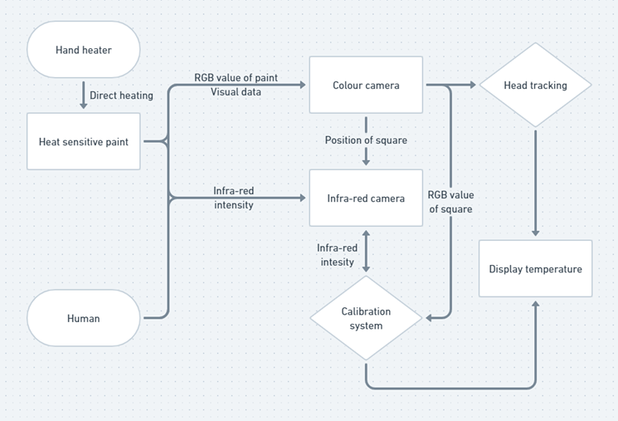
SYSTEM DESCRIPTION

Slide 7
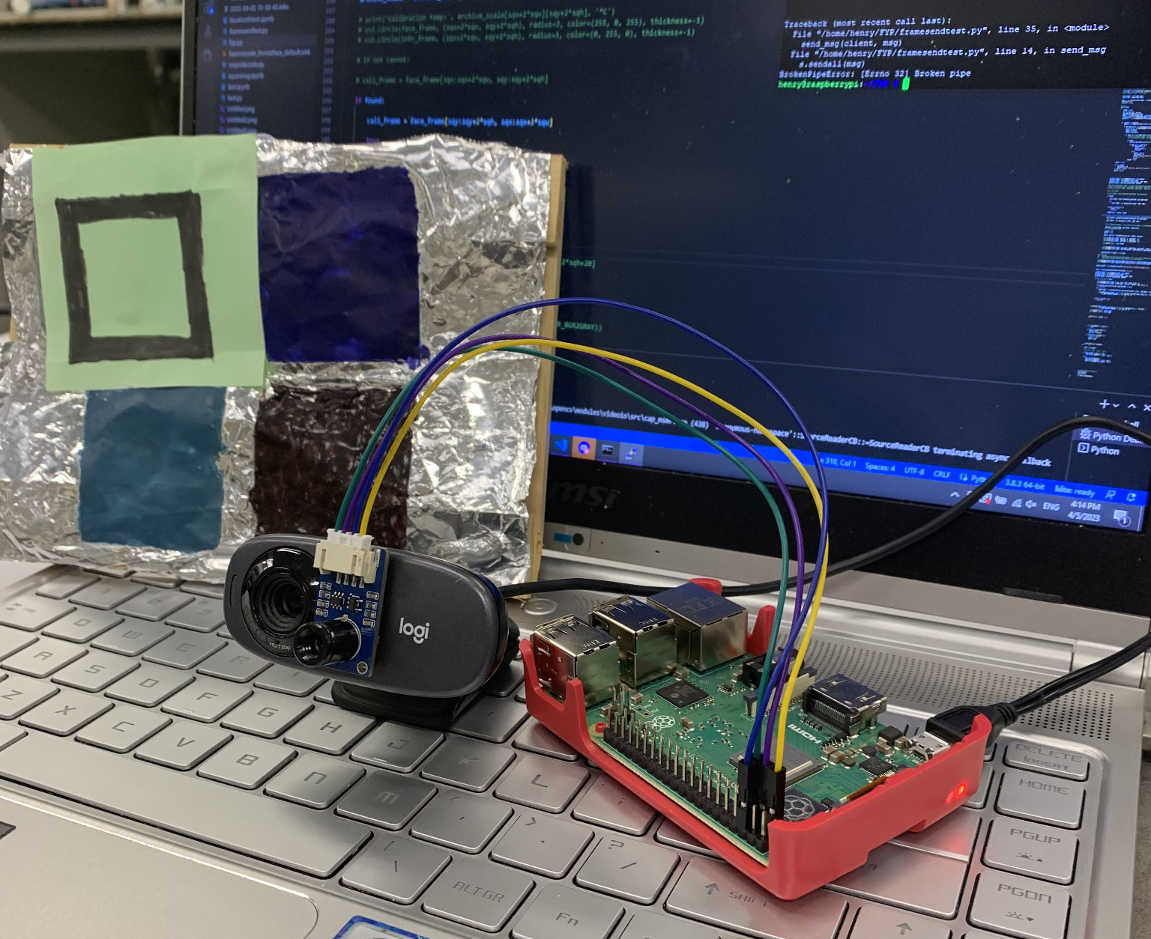
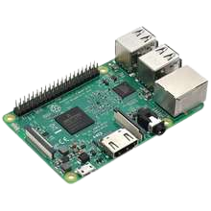
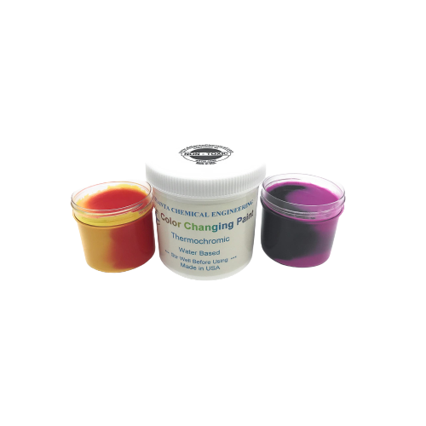
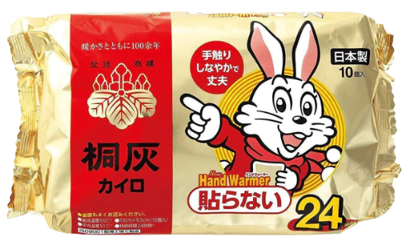
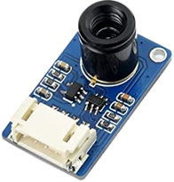
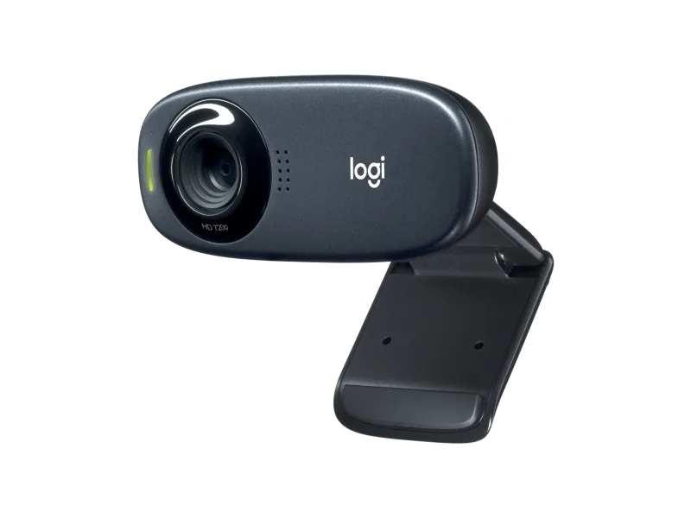
COMPONENTS LIST
RASPBERRY PI
HEAT SENSITIVE PAINT
HEAT SOURCE
RGB CAMERA
THERMAL CAMERA
Raspberry Pi 3B
Color Changing Range of
30 to 40°C
Single-use Warmer Pack
Logitech C310HD Webcam
MLX90641 55° FOV

Slide 8
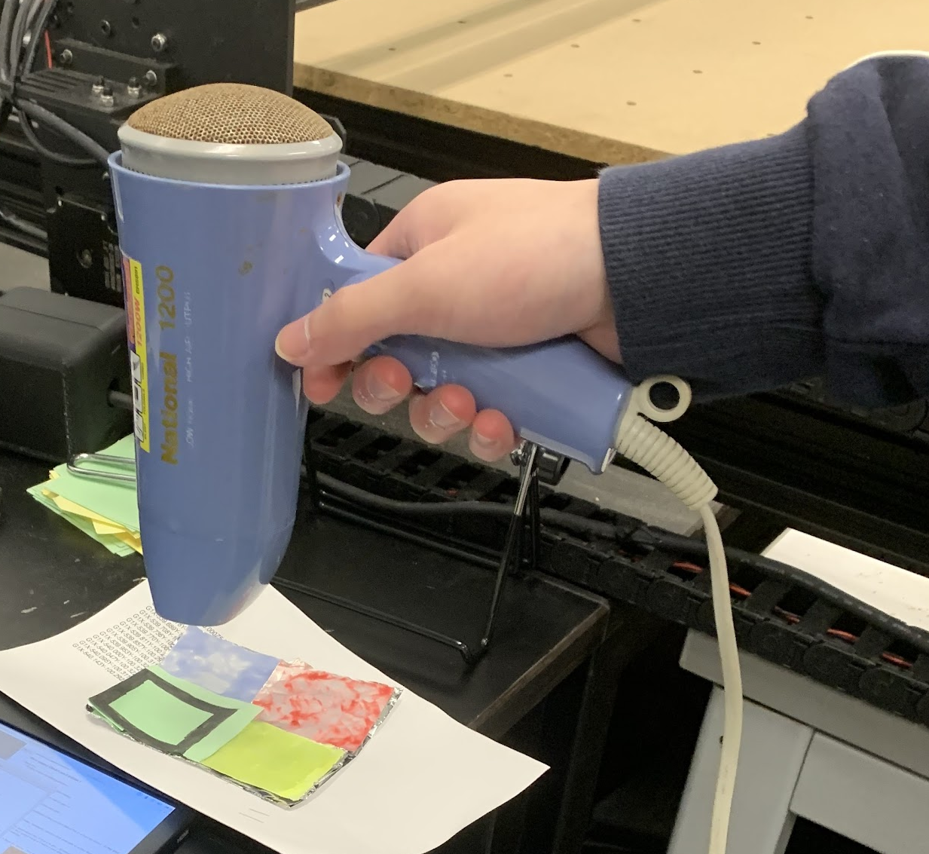
TESTING PROPERTIES OF HEAT SENSITIVE PAINT
The paint shall turn its color within a 30-40ºC range
The color change of the paint shall be sharp enough for machines to distinguish
The color change of the paint shall be swift enough
Paints we chose:
Green->Yellow: 35ºC
Dark Blue-> Light Blue: 38ºC
Deep Brown -> Bright Red: 45ºC

Slide 9
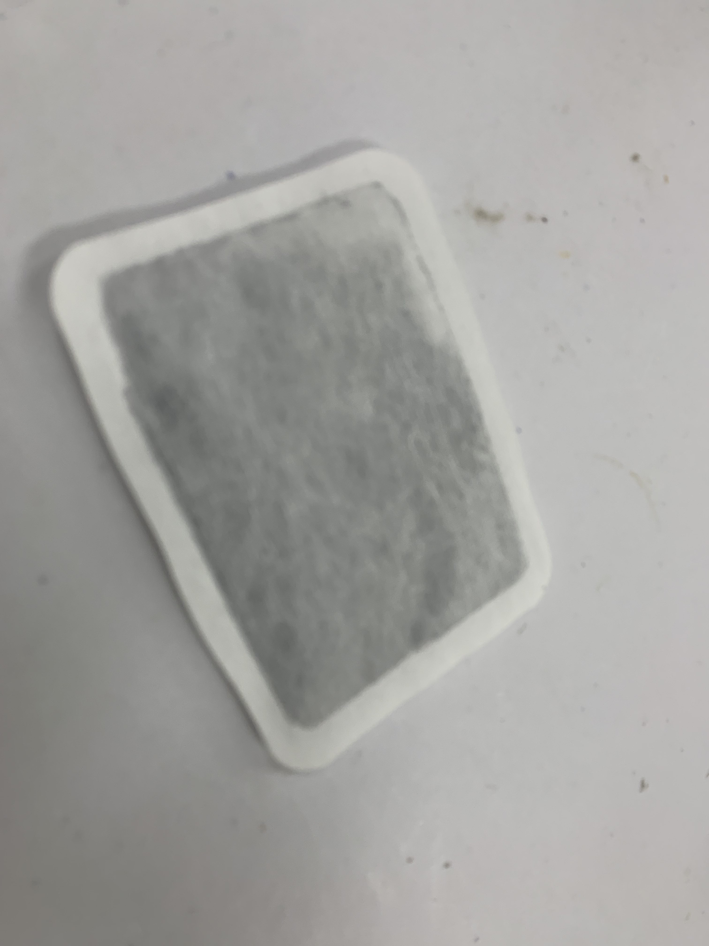
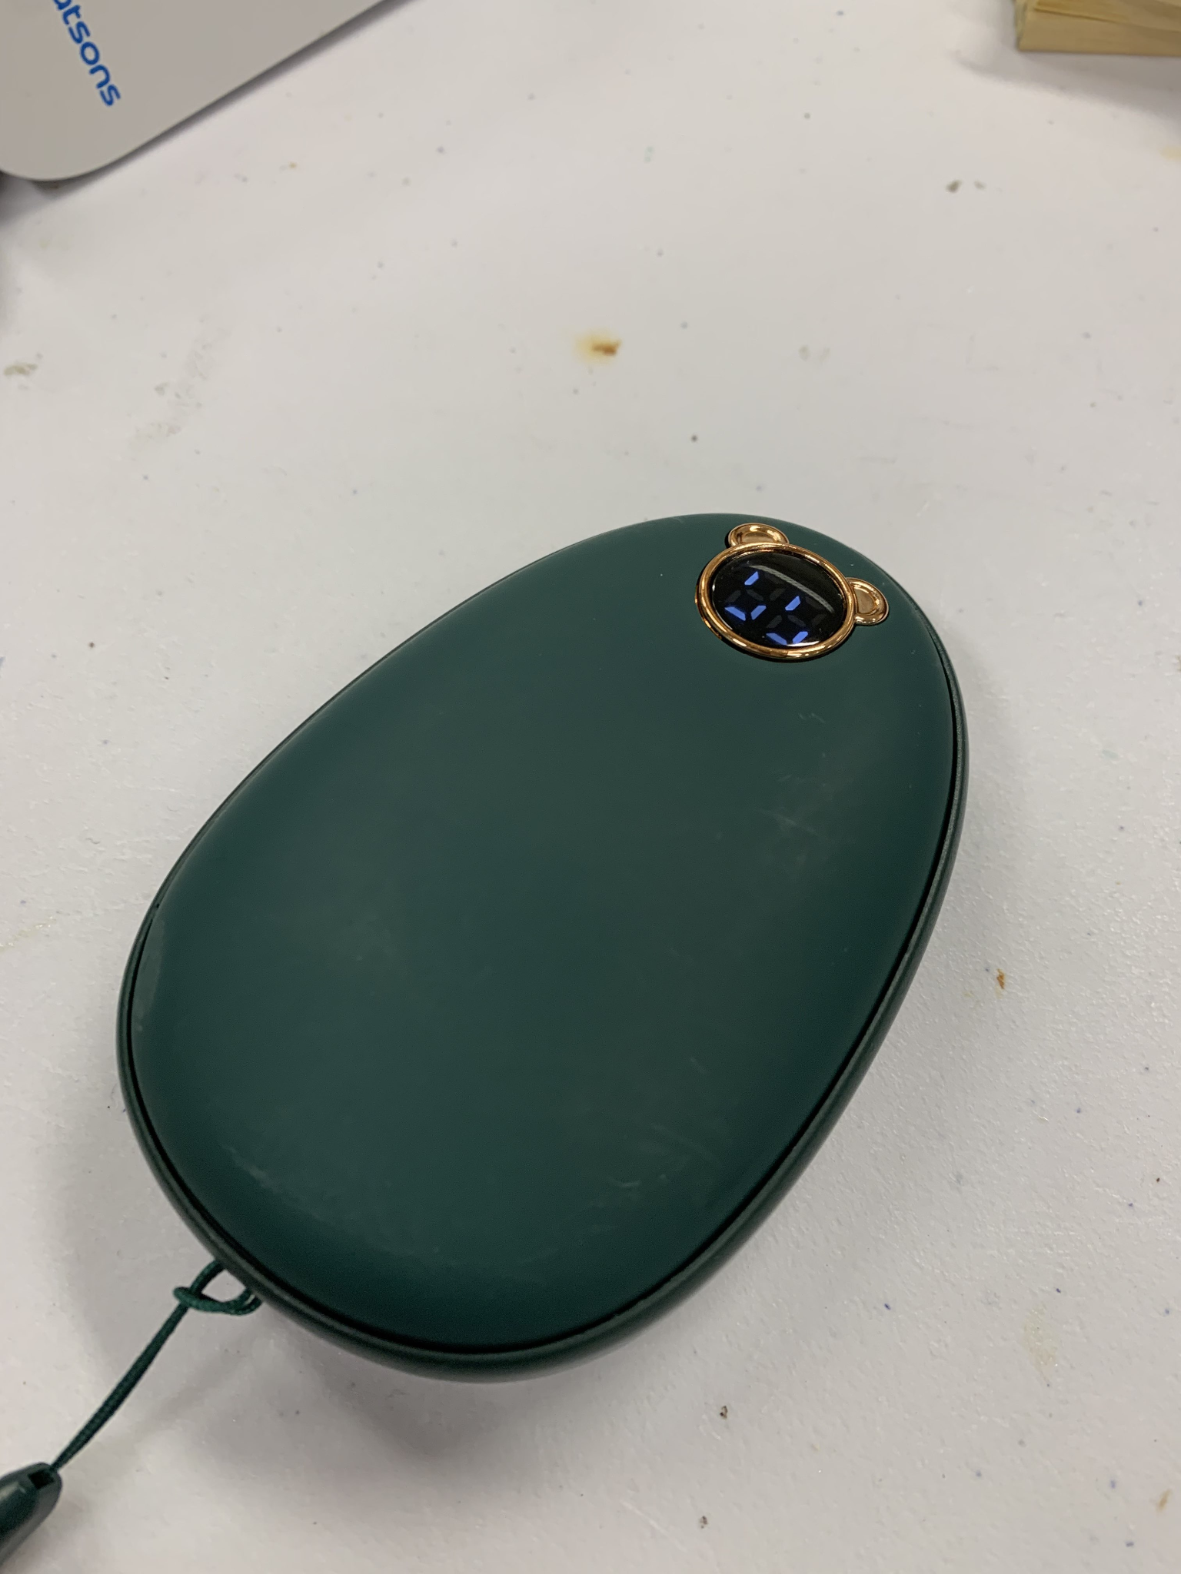
TESTING DIFFERENT ELECTRIC HEATERS OR HAND WARMERS
The temperature of the calibration area should be within 30 – 40°C
Choice between single use hand warmers and electrical hand warmers
 | One-use Warmer Pack | Electrical Warmer
Advantages | -No electricity needed - Long run time(~2 hours or more) -Malleable to fit calibrator | -Usually has around 3 settings for temperature -Rechargable
Disadvantages | -No temperature control -Can’t be reused | -An average run time of less than 1 hour -Rigid but round body -Fragile -Small heating surface area but thick build

Slide 10
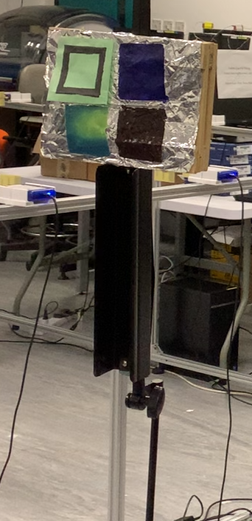
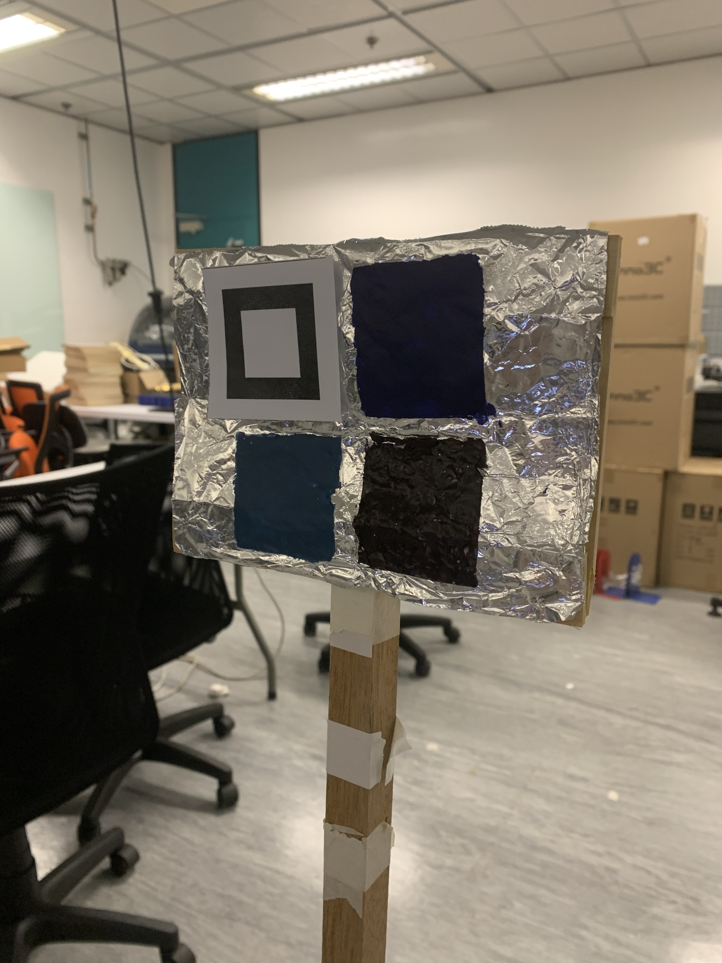
DESIGNING THE CALIBRATOR
The calibration area, including the heater needs to be housed in a housing of some sort
It should be able to either be attached to a wall or be free-standing.
Our enclosure is a simple stand of around 1.5 meters made of wood with a wooden frame to hold our aluminium foiled HSP calibrator as well as our heat pack.
A layout of the calibration has to be designed for the camera to collect data from the HSP
The calibration area was divided into 4 equal squares, 3 squares for 3 paints and top left corner for tracking pattern

Slide 11
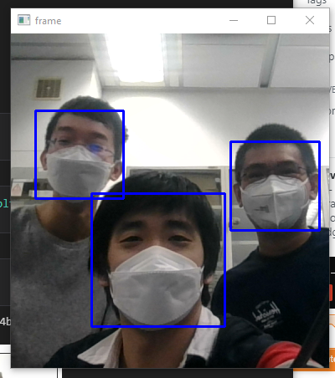
FACE TRACKING
Continuously tracking any people the camera sees to record their body temperature
Machine learning tracking based on faces it identifies after being trained under a library of different faces
Draws rectangles bounding their faces for thermal temperature reading in other parts of the project
It can track multiple people in the same frame, given that they are positioned in view of the camera

Slide 12
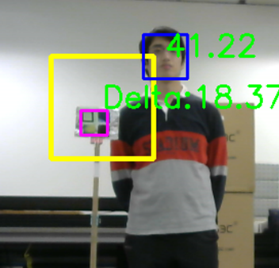
FINDING THE CALIBRATION AREA
Continuously tracking the calibrator in order to read visual data from it
Custom QR pattern
Green paper used such that it can be seen easier by the webcam
Contour detection program that searches for 2 square outlines with same center coordinates
Tracking area denoted by yellow square to reduce processing area and thus improving the tracker’s efficiency
Outcome:
Full auto tracking is effective up to 3 meters
Manual update:
Assumes calibrator stays in place and stops looking for the calibrator until manual input
Effective up to 4 meters

Slide 13
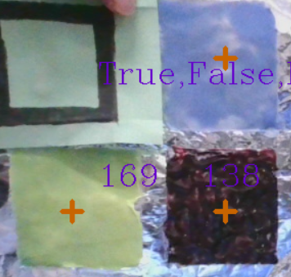
HEAT SENSITIVE PAINT COLOR CALIBRATION
Approximates temperature based on which HSP changes color
If only green paint changes to yellow -> 35ºC, etc.
Brown paint only changes into bright red when temperature reaches 45ºC (not possible for our heat pack)
If Brown paint is detected to change into bright color, something has gone wrong and all color data is ignored (debugger)
Possible noise: unintended bright light source/ heat source nearby

Slide 14
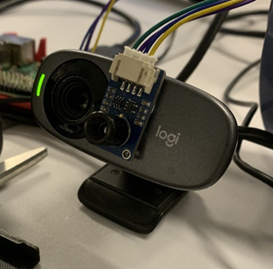
PAIRING RGB & THERMAL CAMERA
 | Logitech C310HD Webcam | MLX90641 Thermal Camera
Resolution | 720p | 24x32 pixels
Framerate | 30 fps | Avg 0.8 fps
Field of View | 60° | 55°
Connection Type | USB connected | 4 I/O pin
Objects 2 meters away are accurately aligned in the images but the images begin to diverge for objects 3.5 meters away
Matching Views Needed:
Cropped the two images such that they overlap as much as possible

Slide 15
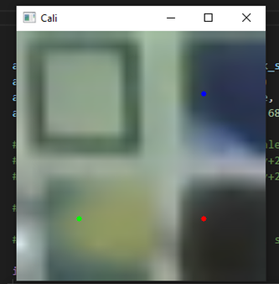
MAPPING COLOR CHANGES OF HEAT SENSITIVE PAINT
Determine the color value where the 3 HSPs change color
Since the color changes were so drastic only one of the 3 values are needed to be taken for more efficient data processing
Green Paint: G value
Blue Paint: B value
Brown Paint: R value

Slide 16
CALIBRATION ALGORITHM FOR THERMAL CAMERA
Develop an algorithm to be able to calibrate the thermal camera with the information provided by the colour camera
If the colour camera detects a colour change in the calibration area, the activation temperature T_A of the heat sensitive paint that changed colour is then compared to the temperature the thermal camera detects at the calibration area T_C
The temperature difference ‘delta’ is then calculated with ∆T=T_A-T_C. With the temperature difference ∆T, all temperatures detected by the thermal camera T is then offset by adding ∆T.

Slide 17
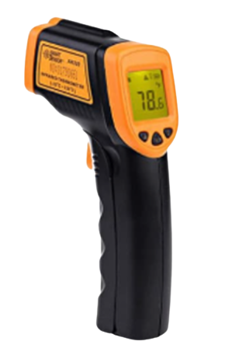
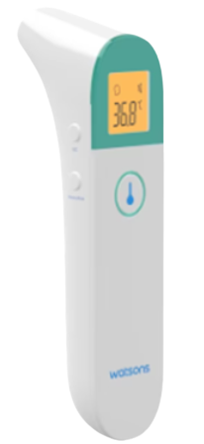
EXPERIMENT BENCHMARK
MLX90641
AR320
WATSON’S DUAL-MODE
INFRARED THERMOMETER
The uncalibrated version of the thermal camera we are using
55ºx 35º FOV
Applied in microwave ovens, movement detection systems, etc.
Ranged Infrared Thermometer
Ranging from -32 - 380ºC
Proclaimed Error Range of +-2ºC
Up to 1 Decimal Place Precision
Used For Fault Detection in Circuit Boards and Other Hardware
Common household thermometer
An effective range of 1-3 cm
Standard benchmark to determine body temperature of intended target
Temperature of the test subject is taken at point blank range multiple times instead of being at various distances

Slide 18
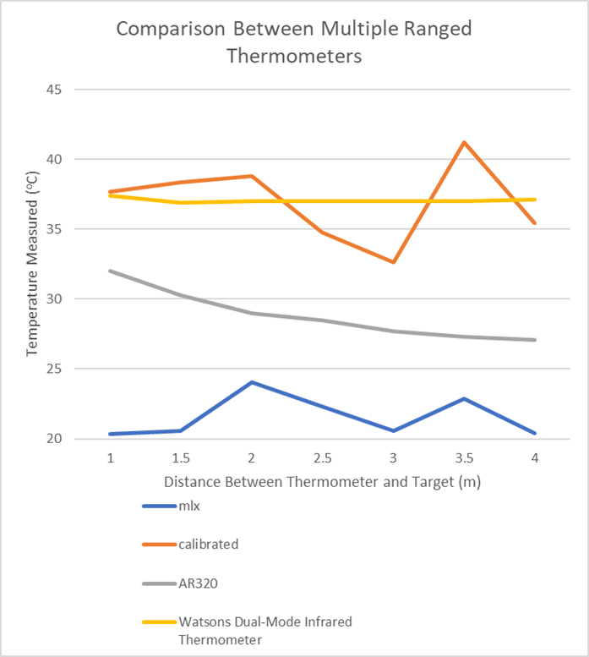
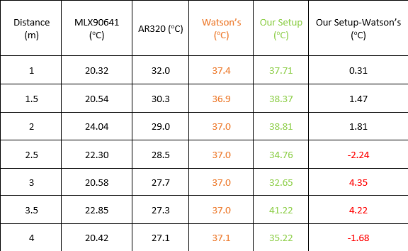
EXPERIMENTAL RESULTS
EXPECTED OUTCOME
ACTUAL OUTCOME
THINGS TO IMPROVE
-Effective Range: >2m
-Accuracy: +-0.1ºC
-Effective Range: 2m
-Workable Range: 4m
-Accuracy : +1.2ºC
Tracker:
-More complex tracker pattern and system
-Increase tracking distance
Calibration Algorithm:
-More complex and refined algorithm
-Increase calibration accuracy

Slide 19
THANKS
Q&A
Please keep this slide for attribution

Slide 20
REFERENCES
PHOTOS
Slide 2: Restaurant To Use Thermal Imaging for Temperature Checks, webpage, https://spectrumlocalnews.com/nc/charlotte/news/2020/05/20/restaurant-to-use-thermal-imaging-for-temperature-checks, [Accessed on :10th May, 2023]
Slide 3: movitherm, Calibrating a Thermal Camera, webpage, https://movitherm.com/knowledgebase/thermal-camera-calibration/ , [Accessed on :1st May,2023]
Slide 4: Seek Thermal, webpage, https://www.thermal.com/seekscan.html , [Accessed on :1st May,2023]
Slide 5: Lo Kin Shing, Fok Hiu Fung, and Chan Ho Lam, “Temperature sensor and camera feedback channel for thermal camera calibration”, Final Year Project, HKUST, 2021. [Accessed: 2nd May, 2023]
Slide 7: Ebay, webpage,https://www.ebay.com.au/itm/172323488321 , [Accessed on :1st May,2023]

